Slide 1
SQUANDER
SPRING 2022 CAPSTONE PROJECT | PROF HENRY WONG
Aakansha Agarwala
Austin Blaise
Nicholas Wong
Rajat Nagavkar
Suryadeep Nallana

Slide 2










AGENDA
Project Overview
Test Cases
Project Requirements
Project Demo (MVP)
Design Architecture
GitHub Walkthrough
Technologies Used
Retrospective
Sprint Overview
Conclusion

Slide 3

PROJECT OVERVIEW

Slide 4
PROJECT OVERVIEW
Squander app provides complete solution to organize and plan the disposal of waste.It uses machine learning algorithm to detect recyclable waste from image and provide way for proper disposal.
What?
Image based Waste detection mobile application
How?
User image submission
Trained machine learning-based model
Results and information
Why?
Image-based
Easy tool to detect waste
Simple steps to undergo
Nearest recycling location provided along with the rates and the options to schedule a pick

Slide 5

PERSONA

Slide 6

Jill, the party host
Background Profile:
Jill, a 32 year old. He is an organiser of a well reputed company in the city. He has organised many big parties and always busy in his job. He takes all the responsibility and his duties also includes providing a good food service. He bets many clients particularly for the food he provides. His organisation is popular among the people Jill does many parties and his collected with more food waste by the end of the party. Jill would like to know the waste identified from the image uploaded, so that he can confirm the photo he uploaded was processable.
How can Squander help?
Jill being responsible for organising the party. He wants to recycle all the waste by segregating in rightful manner and help the surrounding environment. He can use an application. Squander which provides his needs by showing the results of nearest recycling company location for all the food waste from his parties that happen wherever in the city. Squander makes an efficient and easiest way in someone’s life like Jill’s

Slide 7
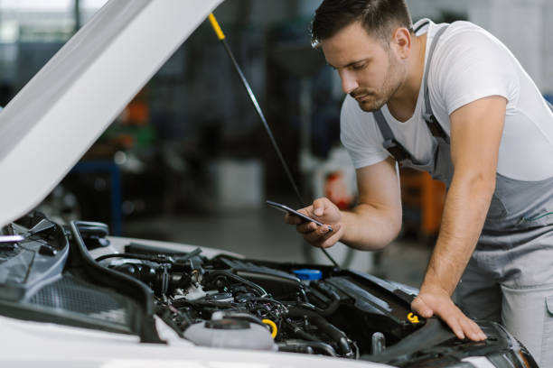
Simon, the mechanic
Background Profile:
Simon is a mechanic from ten years. His age is of 35 years. His jobs is to inspect and repair vehicles, machinery and light trucks. And he is known for his good service providing for his customers. He works in an indoor garage. Simon’s culminated with metallic waste from his work and he wants to find a recycling location to recycle it and make some money from scrap
How can Squander help?
Simon can use the Squander application that helps him to find the nearest recycling company location for the waste to recycle from the comfort of his garage. This would allow him to find and provide easy access directly to the recycling company. He doesn’t have to worry about the waste and where to recycle it. Through Squander it makes his life easier.

Slide 8
PROJECT REQUIREMENTS
Upload Image
Detect Waste
Classify Waste
Receive Results

Slide 9
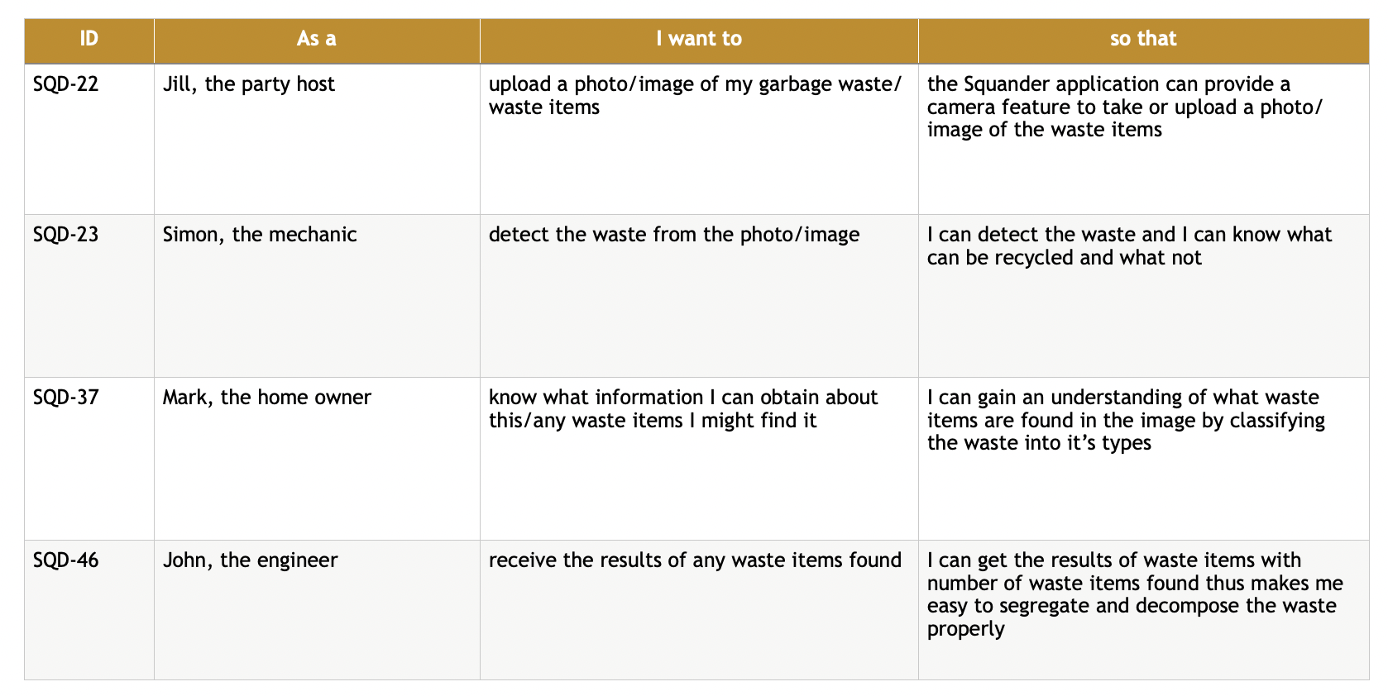
PROJECT REQUIREMENTS - USER STORIES

Slide 10






TECHNOLOGIES USED

Slide 11

ARCHITECTURE DESIGN

Slide 12
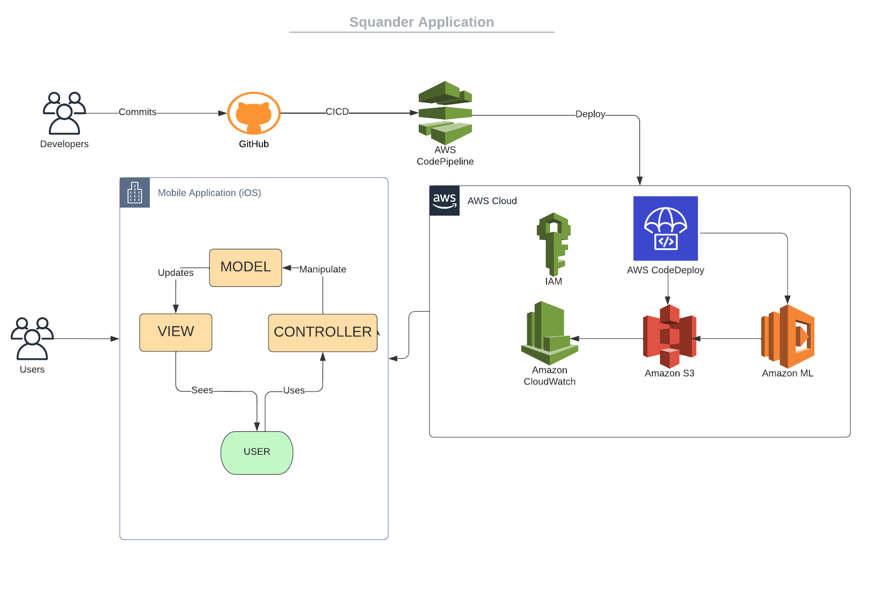
SQUANDER ARCHITECTURE

Slide 13
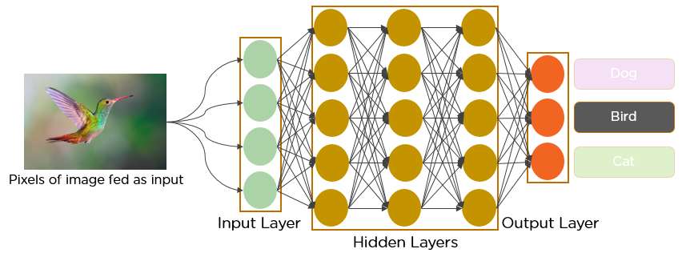
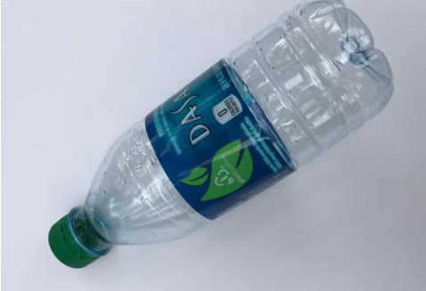
MACHINE LEARNING ALGORITHM
Plastic
Cardboard
Trash

Slide 14
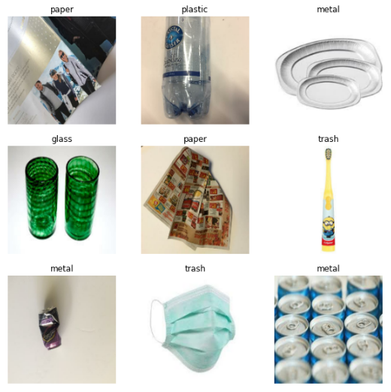
Model: Classification
Model is able to classify trash into the following categories:
Cardboard
Glass
Metal
Paper
Plastic
Miscellaneous Trash

Slide 15
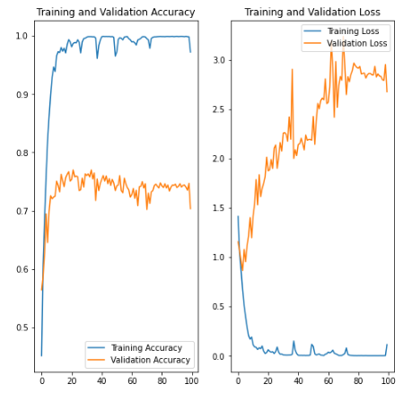
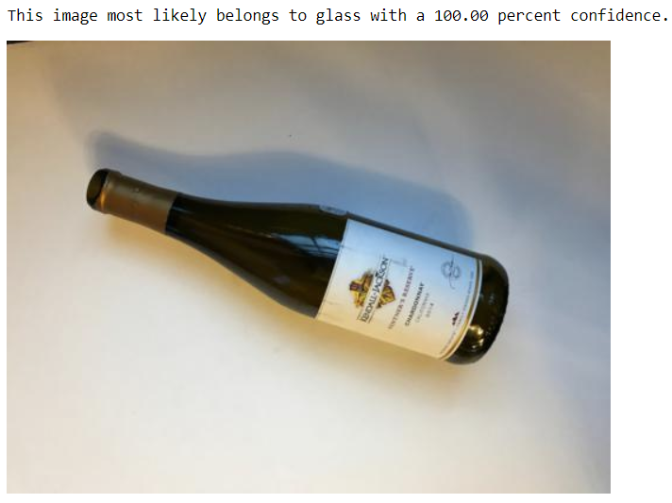
MODEL EVALUATION

Slide 16

SPRINT OVERVIEW

Slide 17
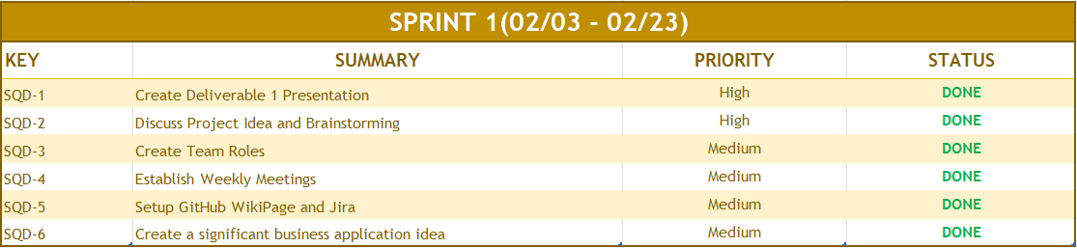
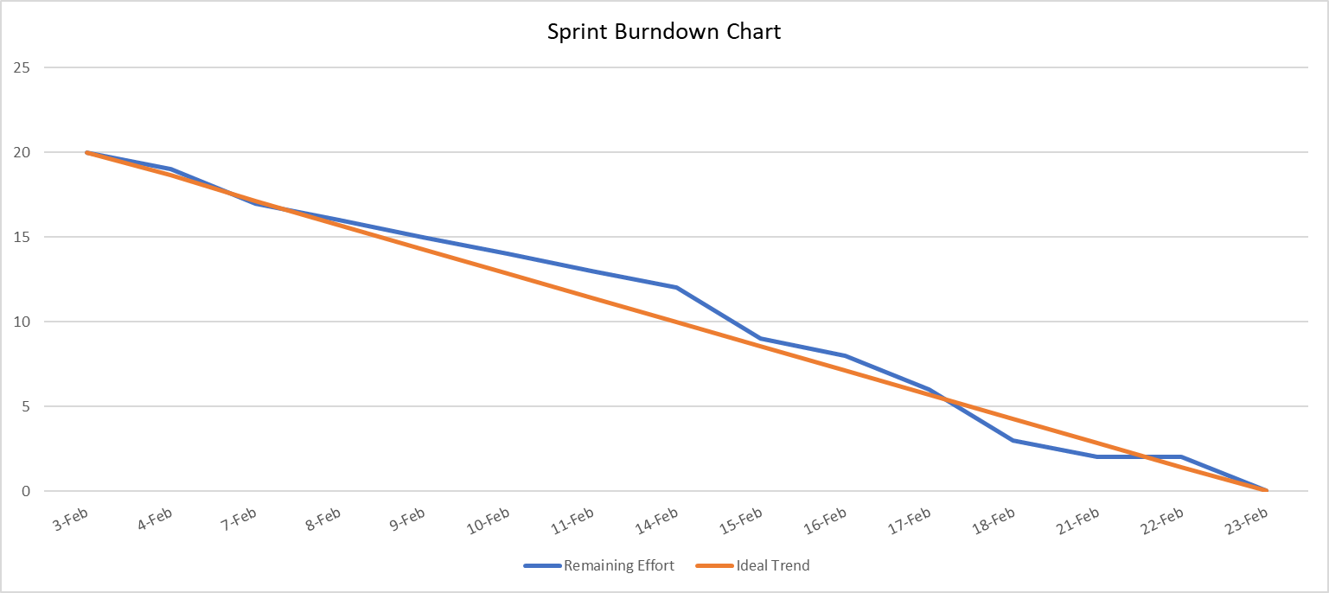
REVIEW SPRINT I

Slide 18
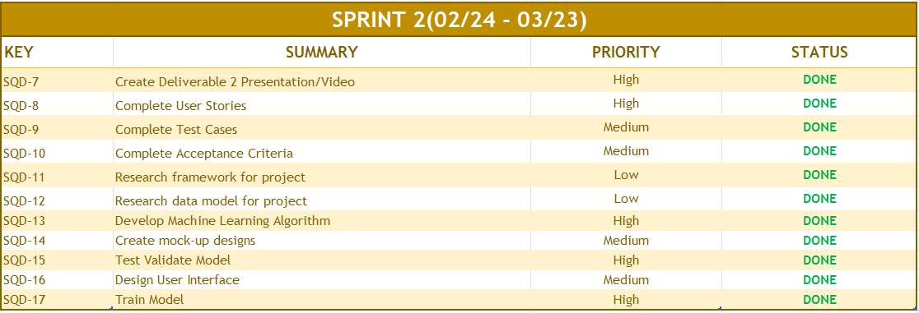
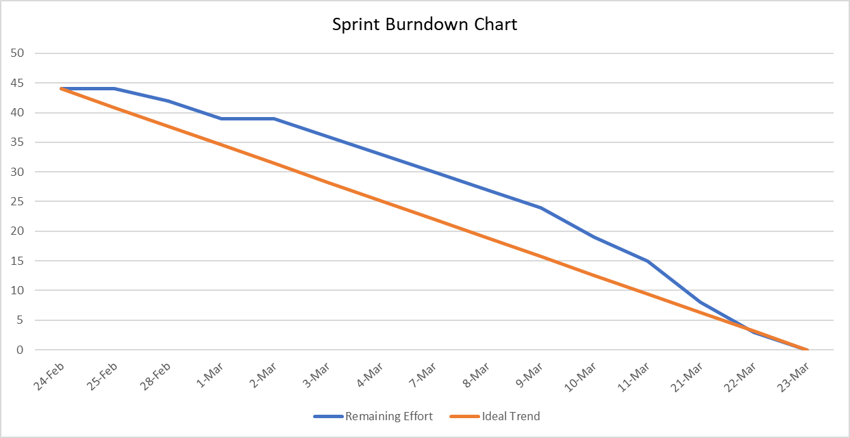
REVIEW SPRINT II

Slide 19
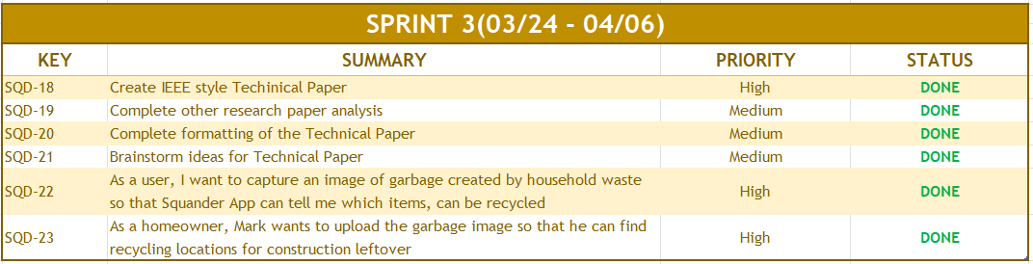
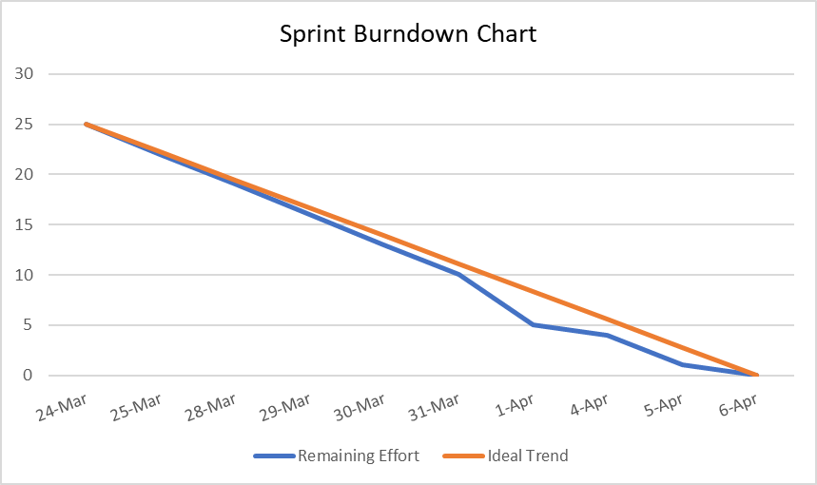
REVIEW SPRINT III

Slide 20
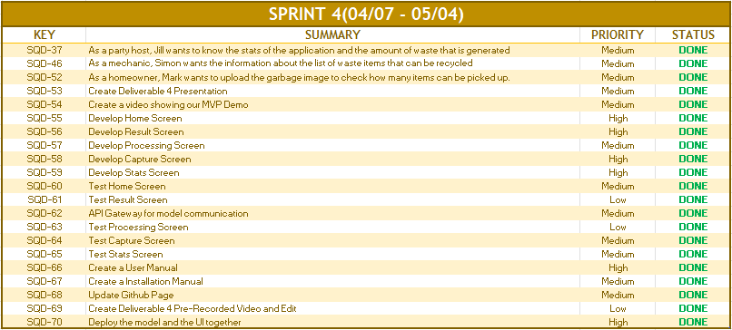
REVIEW SPRINT IV

Slide 21
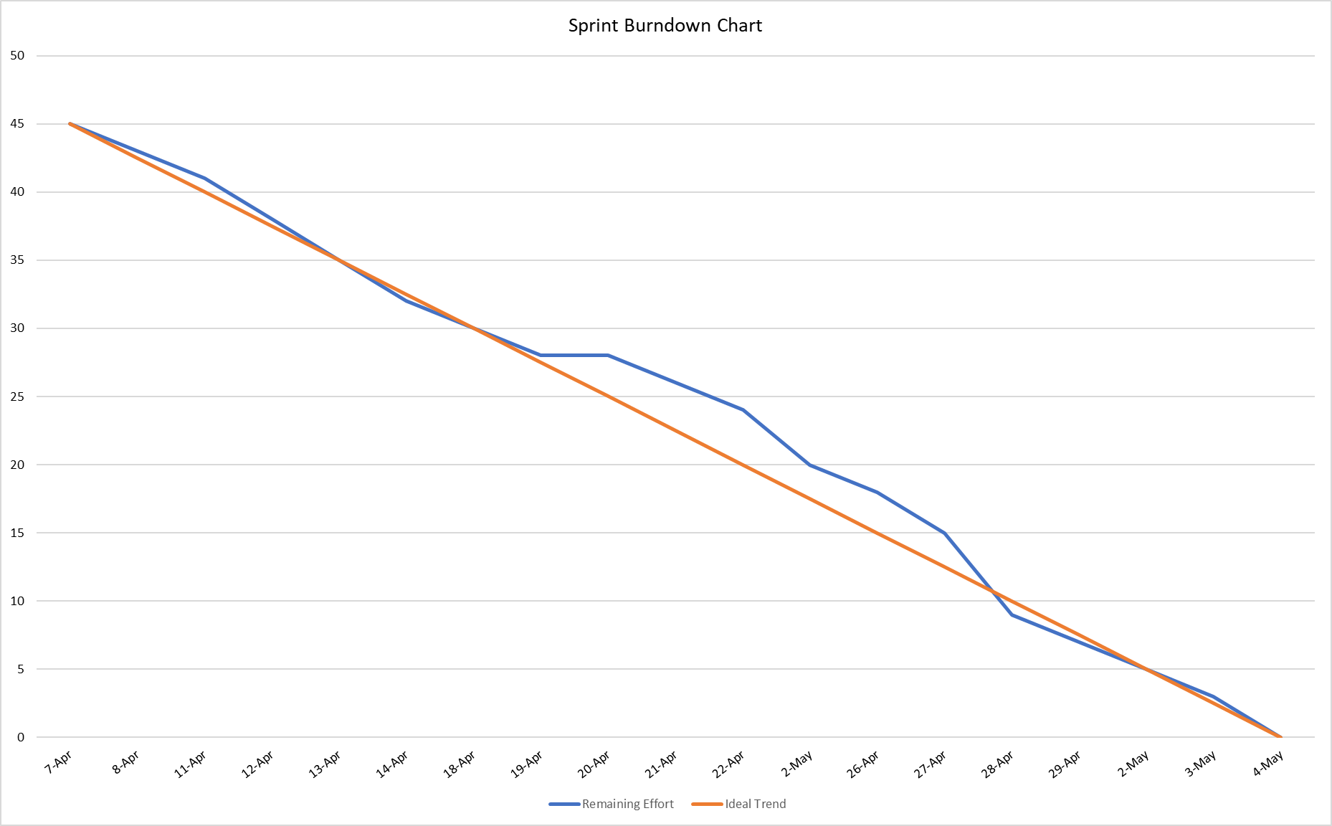
REVIEW SPRINT IV - Burndown Chart

Slide 22

TEST CASES

Slide 23
TEST CASES - HOME SCREEN
Test Case Name | User Story | Test Case ID | Test Action | Expected Results | Test Result | Pass/Fail
Home Screen | SQD-22 | SQD-24 | Browse from the app | User should be able to access the homepage of the app | Once the user opens the app, they are directed to the home screen of Squander | PASS
 |  | SQD-25 | Locate the Recycle Button | User should be able to see the Recycle Button and it should be clickable | Once the user is on the home screen, recycle button is visible and once clicked on the button it is redirected to recycle screen | PASS
 |  | SQD-26 | Locate the Stats Button | User should be able to see the Stats Button and it should be clickable | Once the user is on the home screen, the stats button is visible, and once clicked on the button it is redirected to stats screen | PASS
 |  | SQD-27 | Locate the Contribution Button | User should be able to see the Button and it should be clickable | Once the user is on the home screen, contribution button is visible, and once clicked on the button it is redirected to contribution screen | PASS
 |  | SQD-29 | Click on the earth image | The image should be clickable | Once the user is on the home screen, click on the earth image and it is redirected and opens Camera | PASS

Slide 24
TEST CASES - CAPTURE SCREEN
Test Case Name | User Story | Test Case ID | Test Action | Expected Results | Test Result | Pass/Fail
Capture Screen | SQD-23 | SQD-30 | Locate Camera Button | User should be able to see the camera button and it should be clickable | Once the user is on the capture screen, the camera button is visible, and once clicked on the button it is open the device camera | PASS
 |  | SQD-31 | Locate Photo Library Button | User should be able to see the photo library button and it should be clickable | Once the user is on the capture screen, the photo library button is visible, and once clicked on the button it is photo gallery on the device | PASS
 |  | SQD-32 | Locate Cancel Button | User should be able to see the cancel button and it should be clickable. | Once the user is on the capture screen, the cancel button is visible, and once clicked on the button it is redirected to the home screen | PASS
 |  | SQD-33 | Locate the Camera screen | User should be able to see the camera open. | Once the user clicks on the camera button, the camera gets open and we can take the picture of the waste. | PASS
 |  | SQD-34 | Locate the Retake Button | User should be able to see the Retake Button after taking a picture of the item and it should be clickable | Once the user takes a picture of the waste, the retake button is visible and if the user clicks on the button it is redirected again to open the camera. | PASS
 |  | SQD-35 | Locate the Use Photo Button | User should be able to see the Use Photo Button after taking a picture of the item and it should be clickable | Once the user takes a picture of the waste, the use photo button is visible and if the user clicks on the button it is feed into the model. | PASS
 |  | SQD-36 | Locate Cancel Button | User should be able to see the cancel button and it should be clickable. | Once the user is on the capture screen, the cancel button is visible, and once clicked on the button it is redirected to the home screen | PASS

Slide 25
TEST CASES - STATS SCREEN
Test Case Name | User Story | Test Case ID | Test Action | Expected Results | Test Result | Pass/Fail
Stats Screen | SQD-37 | SQD-38 | Locate Back Button | Users should be able to see the Back Button and it should be clickable | Once the user is on the stats screen, the back button is visible, and once clicked on the button it redirects to home screen | PASS
 |  | SQD-39 | Locate the Recycle Button | Users should be able to see the Recycle Button and it should be clickable | Once the user is on the stats screen, the recycle button is visible, and once clicked on the button it redirects to the recycle screen | PASS
 |  | SQD-40 | Locate the Contribution Button | User should be able to see the Button and it should be clickable | Once the user is on the stats screen, the contribution button is visible, and once clicked on the button it redirects to the contribution screen screen | PASS
 |  | SQD-41 | Locate the Stats Button | Users should be able to see the Stats Button and it should be clickable | Once the user is on the stats screen, the stats button is visible, and once clicked on the button it redirects to the stats screen itself | PASS
 |  | SQD-42 | Locate the Household Clickable Ribbon | Users should be able to see the Household Ribbon and it should be clickable | Once the user is on the stats screen, the household ribbon is visible, and once clicked on the ribbon it will expand and contain all the details of the household like high rise societies, townhouse communities, individual houses etc who have used this application and the amount of waste they generated | PASS
 |  | SQD-43 | Locate the Public place Clickable Ribbon | Users should be able to see the Public place Ribbon and it should be clickable | Once the user is on the stats screen, the Public place ribbon is visible, and once clicked on the ribbon it will expand and contain all the details of the public places like hotels, restaurants, etc who have used this application and the amount of waste they generated | PASS
 |  | SQD-44 | Locate the Industrial Site Clickable Ribbon | Users should be able to see the Industrial Site Ribbon and it should be clickable | Once the user is on the stats screen, the Industrial site ribbon is visible, and once clicked on the ribbon it will expand and contain all the details of the industries like rubber, metal,glass, etc who have used this application and the amount of waste they generated | PASS
 |  | SQD-45 | Locate the Construction Site Clickable Ribbon | Users should be able to see the Construction Site Ribbon and it should be clickable | Once the user is on the stats screen, the Construction site ribbon is visible, and once clicked on the ribbon it will expand and contain all the details of the construction places like homes,factories, etc who have used this application and the amount of waste they generated | PASS

Slide 26
TEST CASES - RESULT SCREEN
Test Case Name | User Story | Test Case ID | Test Action | Expected Results | Test Result | Pass/Fail
Result Screen | SQD-46 | SQD-47 | Locate Back Button | Users should be able to see the Back Button and it should be clickable | Once the user is on the Result Screen, the back button is visible, and once clicked on the button it redirects to the home screen | PASS
 |  | SQD-48 | Locate the Recycle Button | Users should be able to see the Recycle Button and it should be clickable | Once the user is on the Result Screen, the recycle button is visible, and once clicked on the button it redirects to the recycle screen | PASS
 |  | SQD-49 | Display Waste Item List to be dumped | User should be able to see the waste item list having values likes Paper, Plastic, Metal, etc | Once the user is on the Result Screen, waste item list is visible and it contains data like paper, glass,metal,etc | PASS
 |  | SQD-50 | Display the waste item picture | Users should be able to see the waste item picture | Once the user is on the Result Screen, waste item picture is visible | PASS
 |  | SQD-51 | Display the confidence value | User should be available to see the confidence value | Once the user is on the Contribution Screen, it will show the total percentage of global impact on the earth due to the amount of waste generated. | PASS

Slide 27

PROJECT DEMO(MVP)

Slide 28

GITHUB WALKTHROUGH
Link : - https://github.com/anku518/Squander/wiki

Slide 29
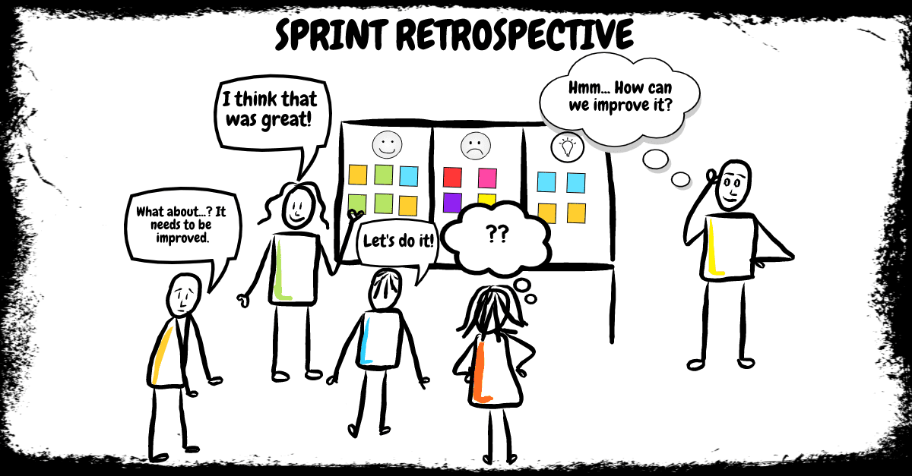
RETROSPECTIVE

Slide 30
RETROSPECTIVE
01
What went well
Completing our work on time
Communication among team members
02
What needs improvement
Coding Redundancies
Tracking of User Stories and Task via Jira.
03
Future Actions
Estimate Project velocities accurately
Find a collaboration tool across platforms

Slide 31

CONCLUSION

Slide 32
CONCLUSION
Application Recap:
Squander facilitates the waste materials of users
Currently can specify cardboard, glass, metal, paper, plastic and miscellaneous trash.
Provides:
Model results
Information on the wastage
Location of the nearest recycling factory
Future Scope:
Improve the algorithm to detect waste more accurately
Increase the quantity of training data
Implement inheritance learning, object segmentation and multiple object recognition.
Add more features to the application such as scheduling and environmental impact tracing.
Provide more informations to users
Recommend recycling locations

